Slide 1



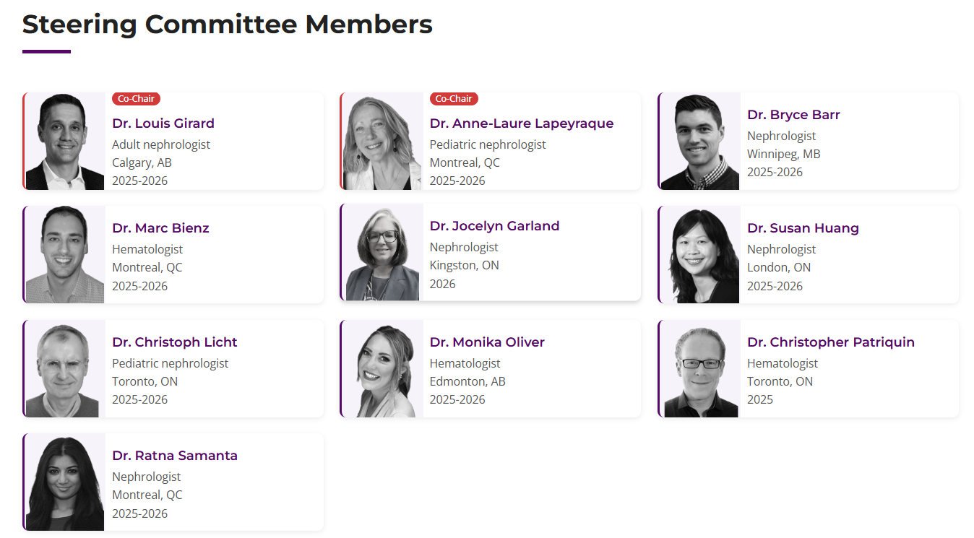




Introducing… the Canadian aHUS Network
Look for more detail in your CSN digital bag
https://ahusnetwork.ca/

